Slide 1
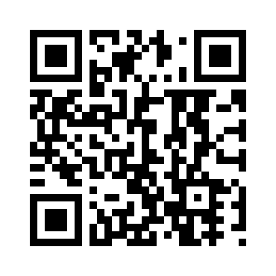

Slide 2
ADASTRA FAST FACTS
INFORMATION INSIGHT
12 OFFICES GLOBALLY
1200+ PROFESSIONALS
$125 MILLION
Total data management and business analytics
international awards
for quality
360+ completed projects
Fluent in 23 languages
Consistent, organic growth
for 20 years
World-class data management and business consulting solutions, services, and software.
From strategy, to delivery, and beyond.

Slide 3
Data-driven business insight
Smart data curation for digital transformation
Learn from those who do it!
Optimize your organization
Machine Learning Boutique
Mobile app solutions for information delivery
Big data monetization & population analytics
We are Adastra Group
Performance apps, crafted to your needs

Slide 4
Adastra Bulgaria
Business Information Management
BA
Business
Analysis
QA
Quality
Assurance
DQ
Data Quality
ETL Data Integration
DM
Advanced Analytics
& Data Mining
MDM
Master Data Management
Consulting
Services
PM
Project
Management
SA
Solution
Architecture
BI
Business Intelligence
DG Data Governance
BIG DATA Solutions
DATA SCIENCE
MM Metadata Management
Fast facts:
Established in 2007
Offices in Sofia and Varna
Our team: 220+ people
In Varna since 2011
85+ people
40+ Multinational clients in North America, Europe, and Bulgaria
Outstanding track record of IM delivery (50+ projects)

Slide 5
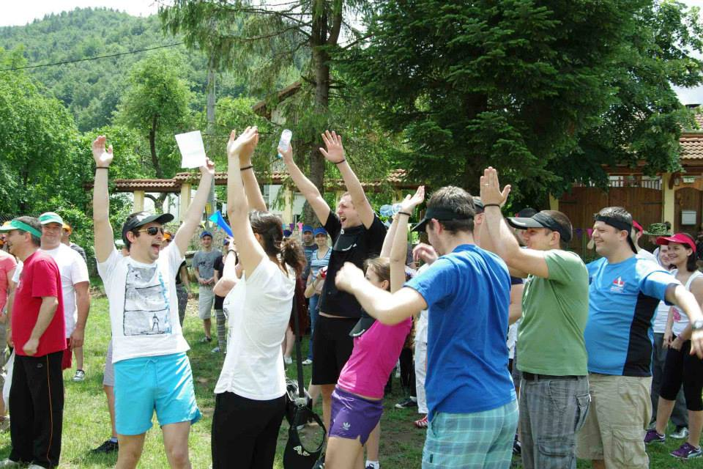
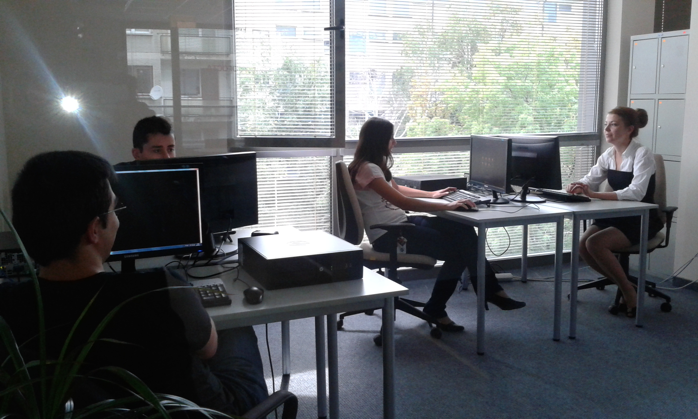
Who We Are
We Are Strong Together…
We Plant Our Ideas With Care To The Business Of Our Clients
We Work Hard…
We Are Talented…
...and Creative…
Successfully Leading The IM Field In Bulgaria
For 10 Years
And it’s all about PEOPLE ☺

Slide 6
Our Business Partners

Slide 7
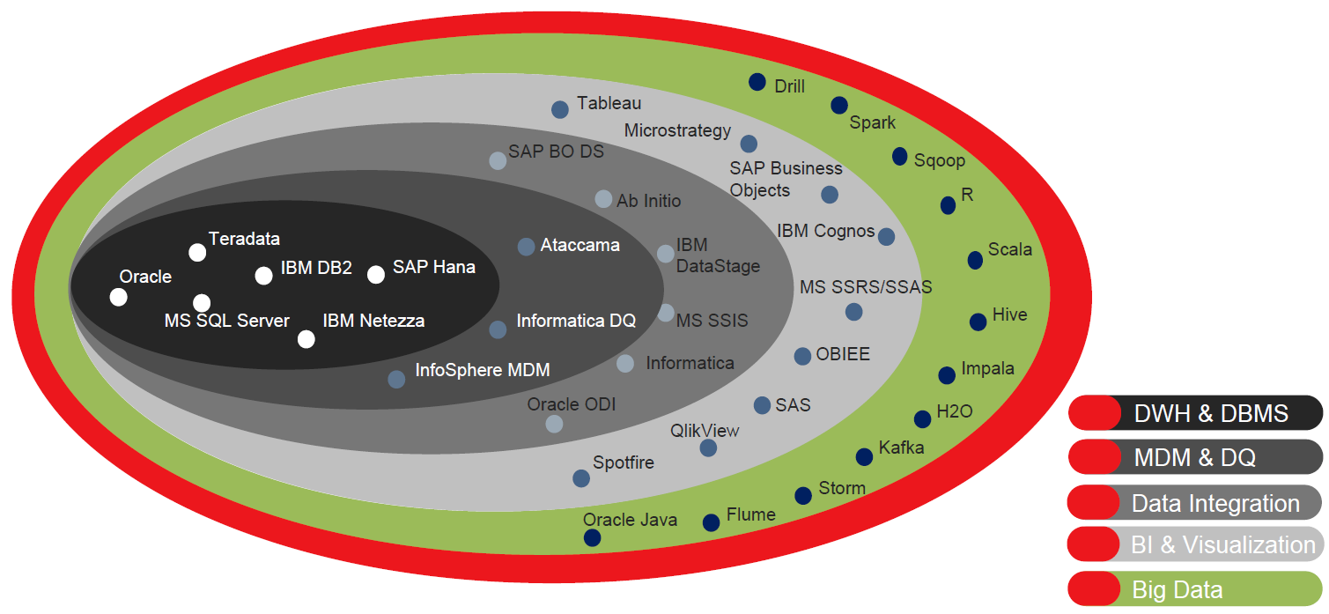
Technological Know- How

Slide 8
Business Information Management
Business Information Management is the process of managing information as a strategic resource for improving organizational performance. This process involves developing strategies and introducing systems and controls to improve information quality to deliver value.

Slide 9
Delivery Markets and Industries
Adastra BG main delivery markets:
Canada (EST-3, GMT-8)
US (EST-1, GMT-6)
Canada (EST, GMT-5)
UK (EST+5, GMT)
Austria (EST+6, GMT+1)
Slovakia (EST+6, GMT+1)
Czech Republic (EST+6, GMT+1)
Germany (EST+6, GMT+1)
Romania (EST+7, GMT+2)
Bulgaria (EST+7, GMT+2)

Slide 10
Data Integration Developer
Design, build, and deploy data integration solutions
Use data integration platforms to extract, transform, and load data into various systems and environments
Design and develop detailed mappings, implementing complex transformation logic, covering different scenarios including big data files and large tables
Perform data analysis for both source and target tables/columns
Design high-level workflows and orchestrate complicated end-to-end solutions
Utilize ETL tools such as Informatica PowerCenter / Informatica BDE, Ab Initio, IBM DataStage, Oracle Data Integrator, Microsoft SSIS and Talend Open Studio in order to implement the transformation logic
Plan and perform production migrations

Slide 11
Reporting and Analytics Developer
Analyze business and reports’ requirements
Translate the reporting requirements into data analysis and reporting solutions
Analyze logical data models and create working frameworks with facts, attributes, hierarchies, metrics, and relationships
Analyze physical sources and create logical tables, dimensions, columns, and aggregation rules
Design and develop reports utilizing BI tools such as OBIEE, SAP Business Objects, IBM Cognos / Cognos TM1, QlikView, MicroStrategy, Microsoft SSRS/SSAS, Tableau, and Power BI
Build dashboards and help in the development of complex ad hoc queries and analyses
Develop ”time to resolution” reports to control data purity

Slide 12
Quality Assurance Analyst
Create and maintain test documentation including strategy and plans
Identify gaps in requirements from the early stages of solution design on
Validate the integrity between requirement documents
Develop test cases that validate the code result against the business logic
Perform functional and system integration testing of various project solutions including:
ETL/ELT – Develop SQL scripts that automate the data transform validation
MDM/DQ – Data cleansing/matching results validation by utilizing user defined functions to reproduce desired per business rules results
BI – Testing report functionality of the developed OLAP reports and the validity of displayed data
Migration/Upgrade – Ensure that both functional and non-functional behavior has not been adversely affected
Analyze test execution results and identify source data, code issues and defects

Slide 13
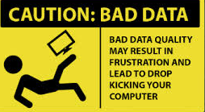
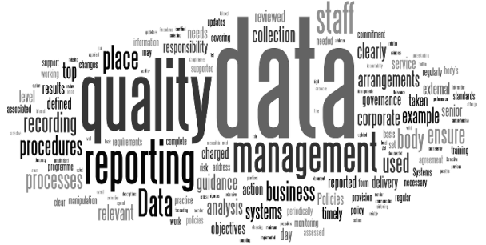
DQ/MDM Consultant
Analyze, design, develop, test and document Data Quality (DQ) and Master Data Management (MDM) processes from detailed and high level specifications, and assist in troubleshooting
Close work with clients in order to identify critical data elements and define data quality criteria including business rules, definitions, and tolerance levels
Establish data quality dimensions, such as data completeness, conformance, consistency, validity, and timeliness
Profiling, Cleansing, Mastering and Monitoring Data utilizing ETL/DQ/MDM tools such as Ataccama, Informatica DQ
Configuration of DQ exceptions managements and reference data management environments

Slide 14
Big Data Engineer
Setup, secure and manage clusters of computers working with the Hadoop Distributed Files System (HDFS) and storing huge volume of data (in the TB magnitude)
Setup and manage NoSQL databases
Batch transfer and integrate data between traditional Data Warehousing systems and HDFS
Integrate real time streaming data from social media, web feeds, sensor data from smart devices, machine logs, etc.
Perform Data Analytics on the accumulated data sets; Data Science
Query and visualize data to drive business insights
Work within the Apache Hadoop Ecosystem and utilize the applications commonly included in the Cloudera, Hortonworks or MapR big data stacks. Develop code in Python, Scala, R or Java

Slide 15
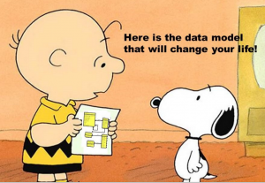
… and more
Business Analyst
Database Admin
Data Architect
Technical Support
Project Manager
Data Scientist

Slide 16
How We Support Our Talents
E-learning platform utilization
Training owners and mentors
Key technical trainings online
On-the-job training and mentoring
Internship programs
Role-specific trainings
Induction trainings
Soft skills trainings
Language trainings
External trainings and certifications
Adastra Academy
Cooperation with universities

Slide 17
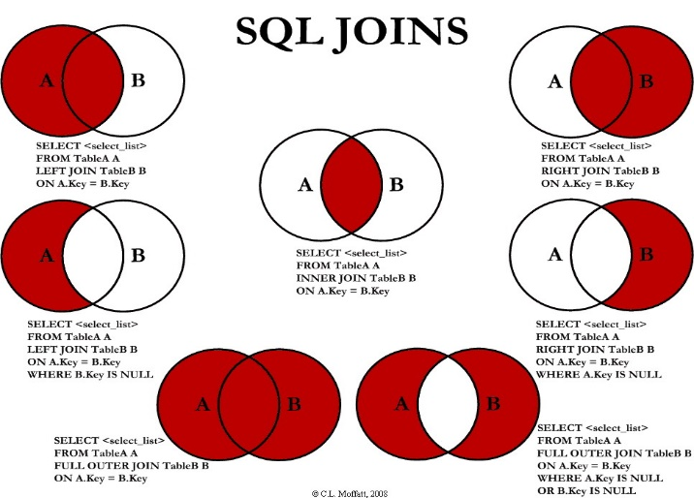
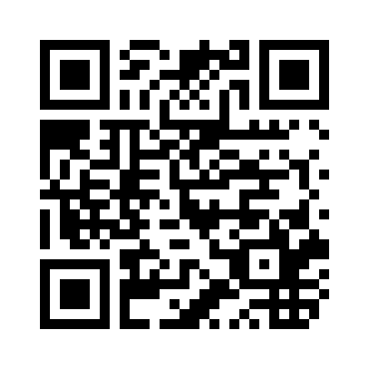
I Feel Ready…
SQL Knowledge
Good communication in English and/or German
Knowledge and/or hands-on experience with: SQL, Excel, Databases and / or OOP languages
You are not afraid of new challenges
Result-oriented and highly energetic individual
Analytical and creative thinker
You can cook ☺
Check out at:

Slide 18
ADASTRA Bulgaria
32 Atanas Dukov Str., 3rd fl
1407 Sofia, Bulgaria
Tel: +359 2 960 00 30
www.adastragrp.bg
jobsbg@adastragrp.com
Blvd. “General Kolev" 113
9000 Varna, Bulgaria
Tel: +359 2 819 34 09

