Slide 1
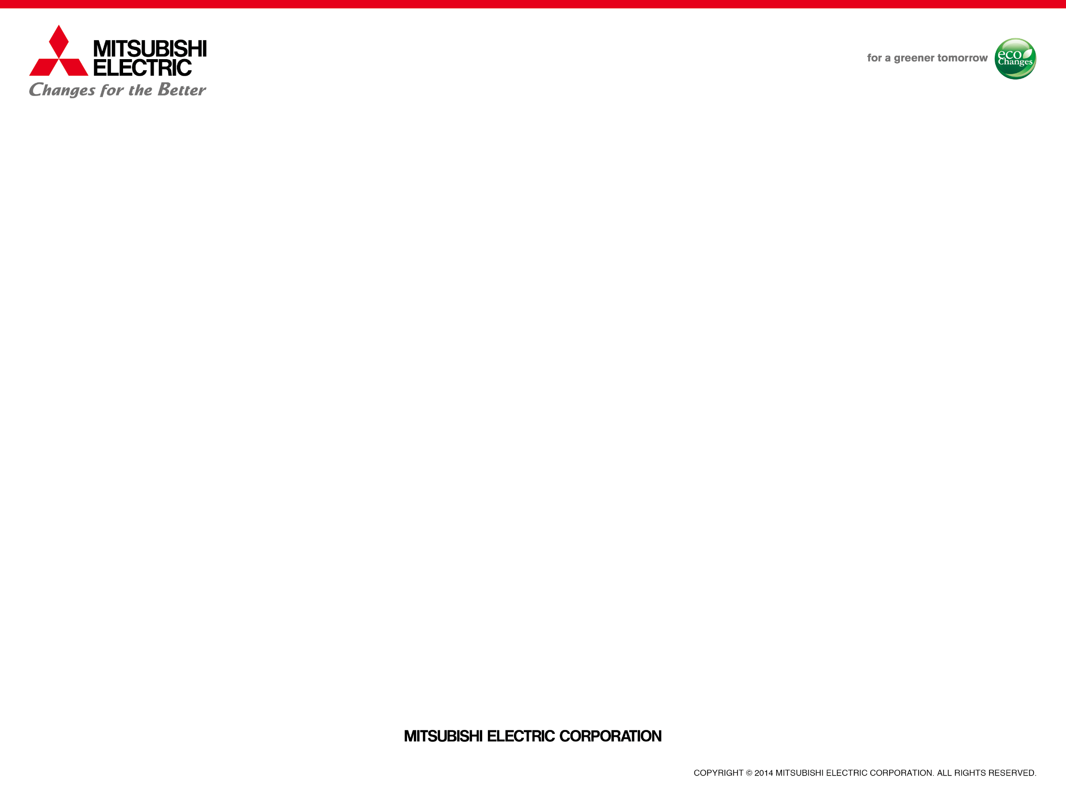

Mitsubishi Electric Corporate Profile

Slide 2
About Mitsubishi Electric

Slide 3
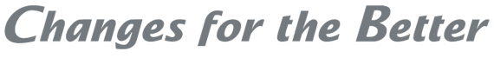
Corporate Mission
The Mitsubishi Electric Group will continually improve its technologies and services by applying creativity to all aspects of its business. By doing so,
we enhance the quality of life in our society. To this end, all members of the
Group will pursue the following Seven Guiding Principles.
Seven Guiding Principles
Trust, Quality, Technology, Citizenship,
Ethics and Compliance, Environment, and Growth
Corporate Statement
Our corporate statement, "Changes for the Better,” signifies the goal and stance of the Mitsubishi Electric Group to continually innovate for the better.

Slide 4
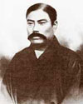
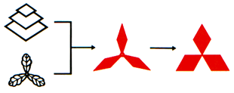
About “Mitsubishi” — Origin
1870
Tsukumo Shokai, which was the origin of Mitsubishi,
was established.
Mitsubishi Sha was established. It promoted its business
diversification and grew as a modern corporation.
Spinning-off of the business departments started.
Mitsubishi Goshi Kaisha became a holding company.
Mitsubishi Electric Corporation was established.
Mitsubishi Headquarters was dissolved.
Each Mitsubishi company started as a new independent entity.
1886
1917
The founder, Yataro Iwasaki
1921
1946
Origin of the
Three-Diamond Mark
Photo courtesy of The Mitsubishi Archives
Mitsubishi Electric Corporation is an independent company like other Mitsubishi companies,
and is separately owned, managed, and operated.
With the exception of other companies in the Mitsubishi Electric Group, it bears no legal affiliation with other companies that have the word "Mitsubishi" in their names.

Slide 5
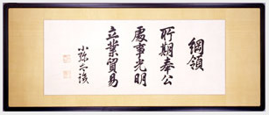
About “Mitsubishi” — Mitsubishi Companies
Mitsubishi companies share a founding management philosophy:
- Corporate Responsibility to Society
- Integrity and Fairness
- Global Understanding through Business
40 member companies of the Mitsubishi Public Affairs Committee
support a variety of philanthropic activities together
The Three Principles
Mitsubishi Electric Corporation
Mitsubishi Heavy
Industries, Ltd.
Mitsubishi Motors Corporation
Mitsubishi Corporation
Electric & Electronics
Ships, Aircraft, Steel Structures,
Power Generation
Automobiles
Trading
The Bank of
Tokyo-Mitsubishi UFJ, Ltd.
Nikon Corporation
Tokyo Marine & Nichido Fire Insurance Co., Ltd.
Kirin Holdings Co., Ltd.
Banking
Cameras, Optical Equipment
Insurance
Food
Mitsubishi Estate Co., Ltd.
Asahi Glass Co., Ltd.
Mitsubishi Research Institute, Inc.
JX Holdings, Inc.
Construction, Real Estate, Hotels
Chemicals, Ceramics & Glass
Consulting & Research
Resources & Energy,
Nonferrous Metals
The companies shown above represent some of the 40 member companies of the Mitsubishi Public Affairs Committee.

Slide 6
Corporate Data
Mitsubishi Electric Corporation
Head Office Location: Tokyo Building, 2-7-3 Marunouchi
Chiyoda-ku, Tokyo 100-8310, Japan
President & CEO:
Established:
Consolidated Net Sales:
Paid-in Capital:
Shares Issued:
Consolidated Total Assets:
Employees:
Masaki Sakuyama
January 15, 1921
¥4,238,666 million (US$37,845,232 thousand)
¥175,820 million (US$1,569,821 thousand)
2,147,201,551 shares
¥4,180,024 million (US$37,321,643 thousand)
138,700
(As of March 31, 2017. US dollar amounts are converted from yen at the rate of ¥112=US $1)

Slide 7
Organization
Board of Directors
President & CEO
Executive Officers
Administration Divisions
Business Divisions
• Auditing
• Strategic Planning
• IT Strategy
• Associated Companies
• Government & External Relations
• Administration
• Human Resources
• Accounting
• Finance
• Purchasing
• Public Relations
• Advertising
• Legal & Compliance
• Export Control
• Licensing
• Intellectual Property
• Marketing
• Global Strategic Planning & Marketing
• Public Utility Systems Group
• Energy & Industrial Systems Group
• Building Systems Group
• Electronic Systems Group
• Communication Systems Group
• Living Environment & Digital Media Equipment Group
• Factory Automation Systems Group
• Automotive Equipment Group
• Semiconductor & Device Group
• Information Systems & Network Service Group
Regional Corporate Offices:
Americas (U.S.A.) / Europe (U.K.) / Asia (Singapore) / China / Taiwan
• Total Productivity Management & Environmental Programs
• Research & Development

Slide 8
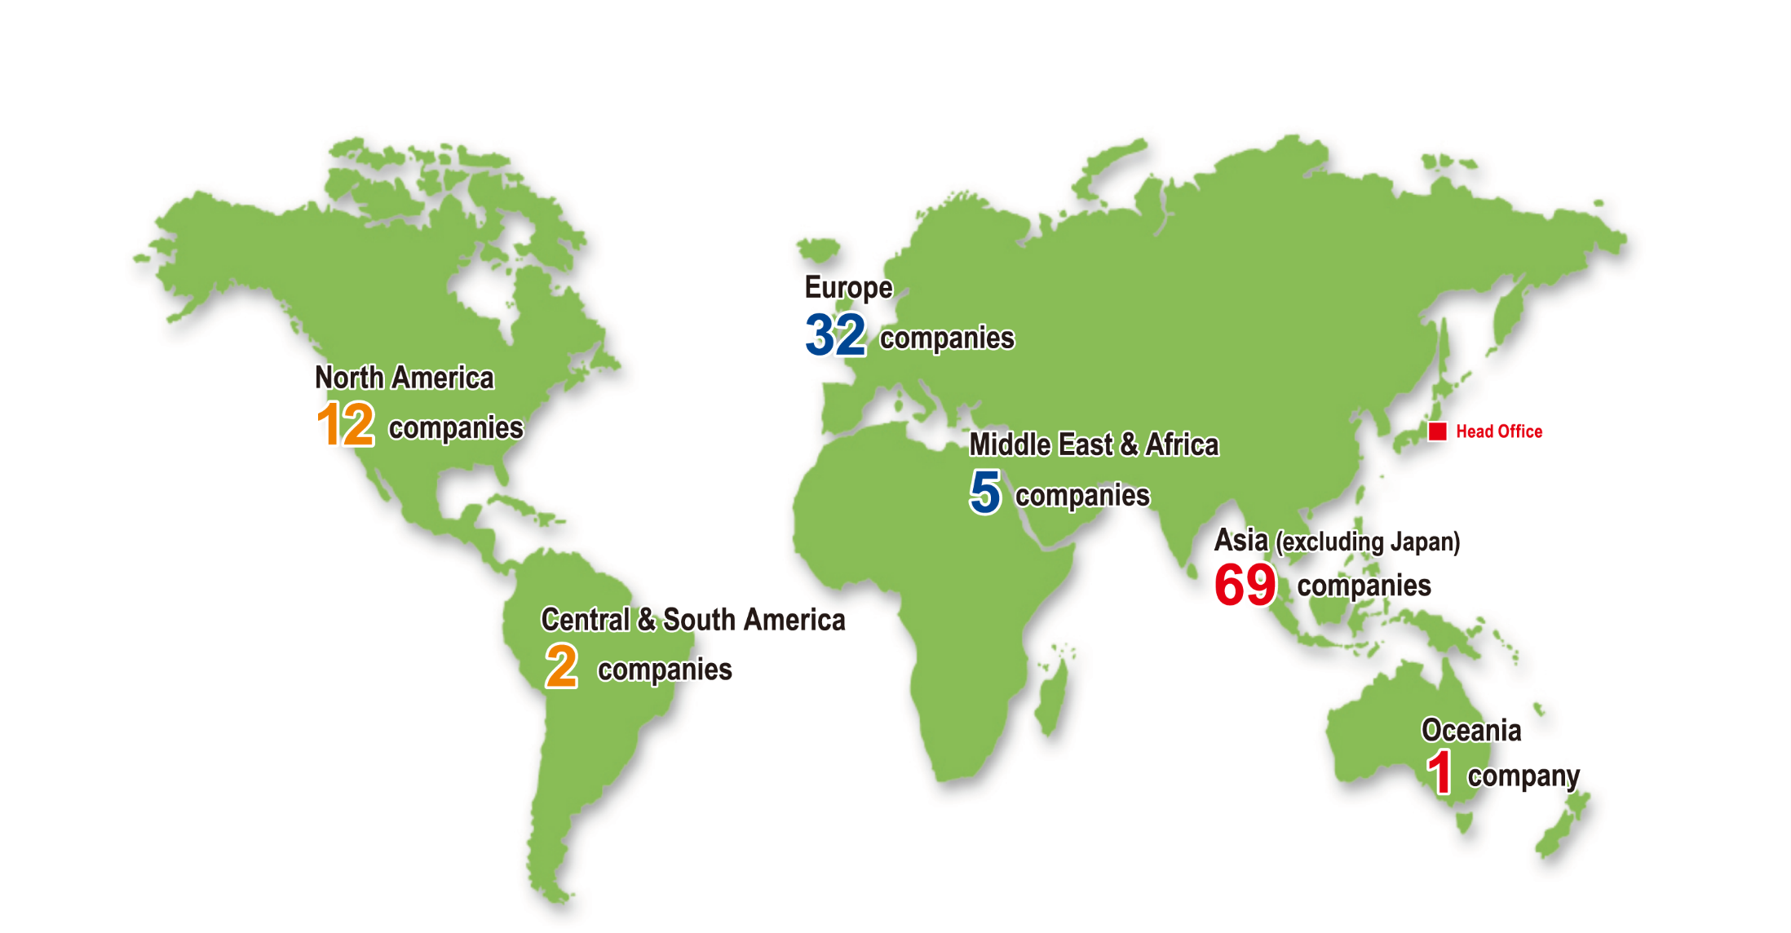
Global Network
Growing international network of R&D, production, sales, associated companies, and other operations throughout the world (includes only consolidated subsidiaries)
(as of Jun., 2016)

Slide 9
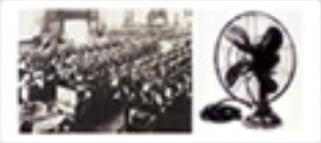
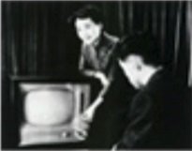
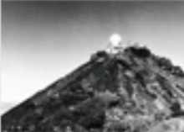
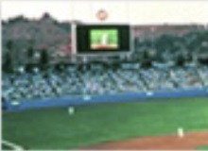
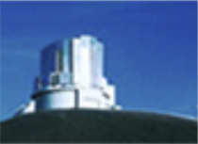
Historical Highlights
1921
1921
I
1923
1931
1949
1953
1964
1969
1970
1980
1989
1999
Mitsubishi Electric Corporation established (Capital: 15 million yen)
First consumer product: ELECTRIC FANS (Approx. 10,000 manufactured)
First Mitsubishi ELEVATOR delivered
Listed on Tokyo & Osaka stock exchanges
Launched first Mitsubishi TELEVISION
Supplied RADAR EQUIPMENT to weather station atop Mt. Fuji
Prime contractor for Japan's first SATELLITE (for ionosphere sounding)
Introduced LOSSNAY heat-exchange ventilation system
Delivered first outdoor color VIDEO DISPLAY, Diamond Vision (Dodger Stadium, Los Angeles)
Listed on London & Paris stock exchanges
Actuator technologies for Subaru TELESCOPE in Hawaii, USA
(National Astronomical Observatory Japan)
1921–23
Electric fan
1953
First Mitsubishi television
1964
Weather station
1980
Diamond Vision
1999
Subaru Telescope

Slide 10
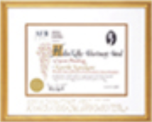
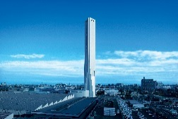
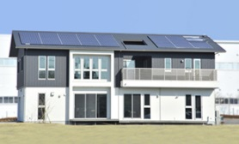
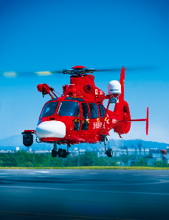
Historical Highlights
2000
2002
2005
2007
2009
2011
2012
2013
2014
Helen Keller Achievement Award 2000, for programs for the sight impaired
(Mitsubishi Electric & Electronics USA, Inc.)
“KASUMI” selected as the standard ENCRYPTION ALGORITHM for GSM mobile telephones
World’s first company to obtain official manufacturing approval for CARBON ION PARTICLE BEAM TREATMENT system
World’s tallest elevator testing tower at the time, measuring 173m
Successful docking of the H-II Transfer Vehicle with the International Space Station
Commenced full-scale operations of the Smart Grid and Smart Community demonstration facilities in Amagasaki and Wakayama.
Received an order to deliver the world's fastest ELEVATOR to Shanghai Tower in China (18m/sec.; slated for completion in 2015)
Installed a PV-EV Linked Inverter in the Ofuna SMART HOUSE, creating the industry's
first PV-EV Linked HEMS
Delivered world’s first helicopter satellite communication system
Unveiled world's largest full ultra-HD video display in Times Square, New York City
2000
Helen Keller Award
2007
World’s highest class of elevator testing tower
2012
Ofuna Smart House
2013
Helicopter Satellite Communication System

Slide 11
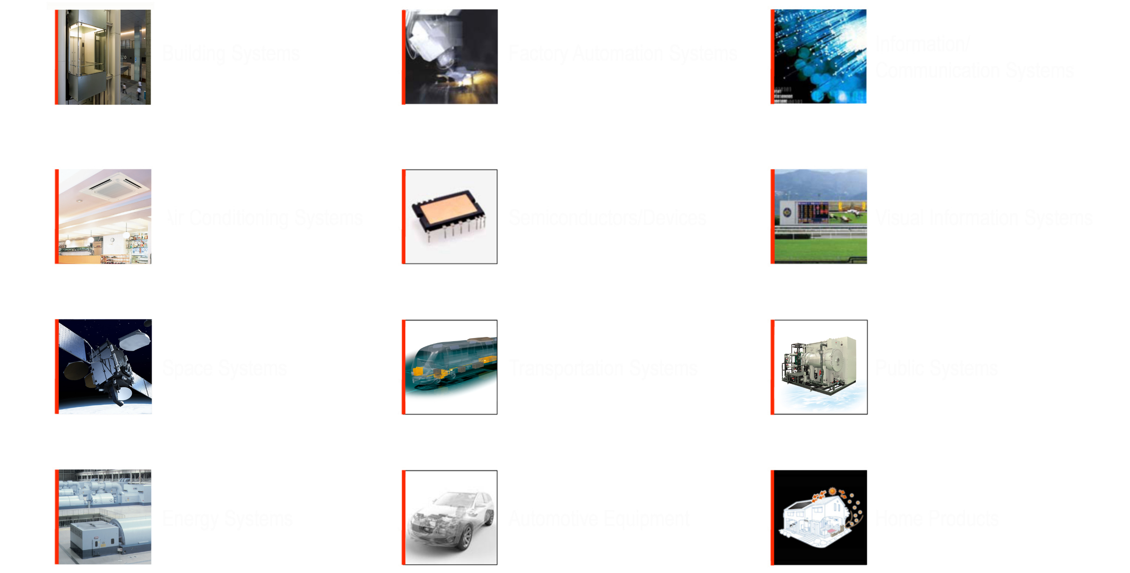
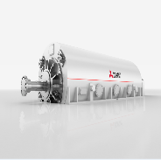
Products & Services
Building Systems
Factory Automation Systems
Information/
Communication Systems
Air Conditioning Systems
Semiconductors/Devices
Visual Information Systems
Space Systems
Transportation Systems
Public Systems
Energy Systems
Automotive Equipment
Home Products

Slide 12





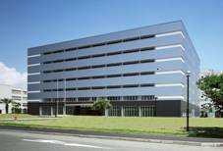
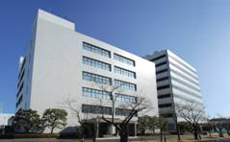
Global R&D Network
Mitsubishi Electric R＆D Centre Europe
Mitsubishi Electric Research Laboratories
(MERCE)
Energy & Environment Technology
Communication Technology
(Rennes, France and Livingston, UK)
(MERL)
Mechatronics
Information & Communication
(Massachusetts, USA)
Mitsubishi Electric (China)
(R&D Dept.)
R&D in Japan (2 locations)
Advanced Technology R&D Center (ATC)
Information Technology R&D Center (ITC)
Power Electronics Technology
Electrical Technology
Environmental, Energy and Materials Technology
Device Technology
System Technology
Imaging Technology
(Hyogo Prefecture)
Information Technology
Communications Technology
Multi-Media Technology
Optical and Electrical Wave Technology

Slide 13
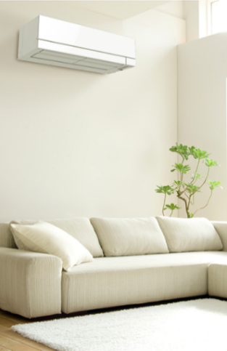
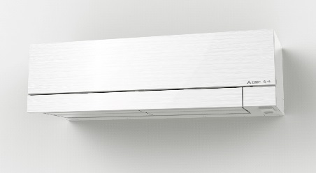
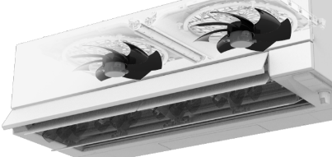
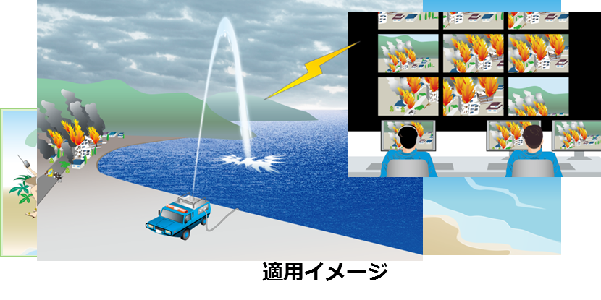
Recent R&D topics
Personal Twin Flow, featuring two independent-driven left and right side fans, creates separate temperature spaces tailored to the preferences of different people in the same room, providing both a high level of comfort while reducing energy consumption.
SeaAerial, which shoots a column of seawater into the air to create a conductive plume for the transmission and reception of radio frequency waves. The system can be easily implemented offshore or along shorelines.

Slide 14
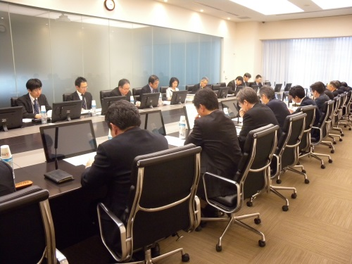
Corporate Social Responsibility
Corporate Social Responsibility (CSR) is an integral part of all business activities
Our Policy of CSR
The Mitsubishi Electric Group promotes its CSR activities based on the conviction that all business activities must take CSR into consideration. The Group‘s Corporate Mission and Seven Guiding Principles (Trust, Quality, Technology, Citizenship, Ethics and Compliance, Environment, and Growth) form its basic CSR policies.
Promotional System for CSR
CSR Committee
Company-wide CSR activities are coordinated by a CSR Committee. The Committee is composed of the heads of management departments at Mitsubishi Electric, and discusses the achievements of activities performed during the previous fiscal year, decisions on future activity plans, and responses to law amendments, from a cross-cutting perspective across the entire Mitsubishi Electric Group.
Based on the awareness that CSR activities are directly linked to corporate management, specific activities are carried out at the responsibility of departments, based on the CSR policy of the Mitsubishi Electric Group.
President
Executive Officers’
Meetings
CSR Committee
(Secretariat)
Departments
Affiliates
in Japan
Overseas
Affiliates
Promotional System for CSR

Slide 15




Corporate Social Responsibility
Addressing Core CSR Issues
The Mitsubishi Electric Group is a global, leading green company that contributes to the realization of a prosperous society. As part of this effort, we have established four core CSR issues (called "materiality"), which are based on international standards and other factors as well as stakeholder expectations.
The Mitsubishi Electric Group's four core CSR issues
Realize a sustainable society
Provide safety, security, and comfort
Respect human rights and promote the active participation of diverse human resources
Strengthen corporate governance and compliance on a continuous basis

Slide 16
Philanthropic Activities
Philosophy and Policies on Philanthropic Activities
Philosophy
As a corporate citizen committed to meeting societal needs and expectations, the Mitsubishi Electric Group will make full use of the resources it has at hand to contribute to creating
an affluent society in partnership with its employees.
Policies
We shall carry out community-based activities in response to societal needs in the fields of social welfare and global environmental conservation.
We shall contribute to developing the next generation through activities that support the promotion of science and technology, culture and arts, and sports.

Slide 17
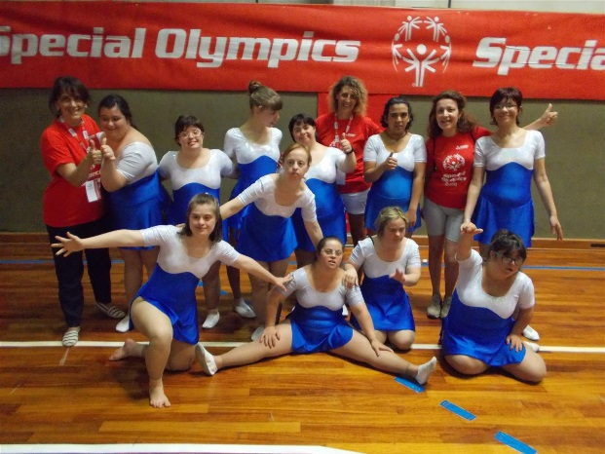
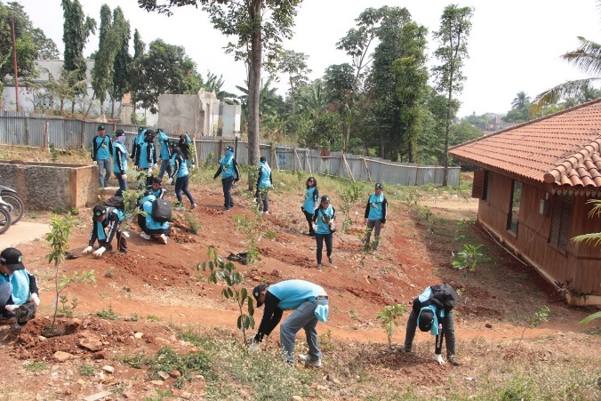
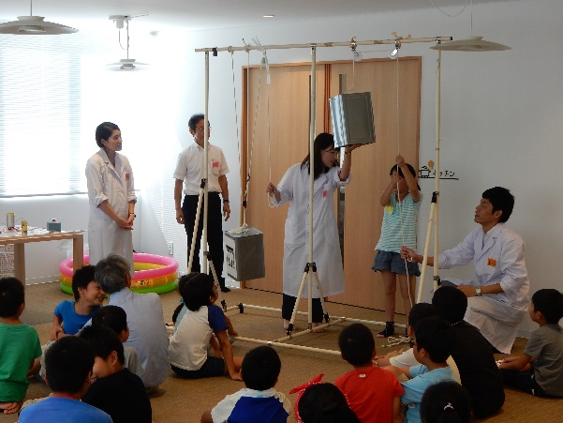
Philanthropic Activities
Through a broad range of philanthropic and volunteer activities in Japan and around the world, the Mitsubishi Electric Group is in touch with the unique needs of local communities and carries out various initiatives to help make a difference.
Support for local events as part of ‘Special Olympics’ which is recognized by the IOC as an event for people with intellectual disabilities in Germany and Italy.
Many employees of Mitsubishi Electric companies in the Asia region enjoy tree planting activities with local people in each community.
Science workshops and presentations at schools and local events teach children how science can be interesting in Japan.
(photo: telling children how an elevator works
by showing a block and tackle system)

Slide 18
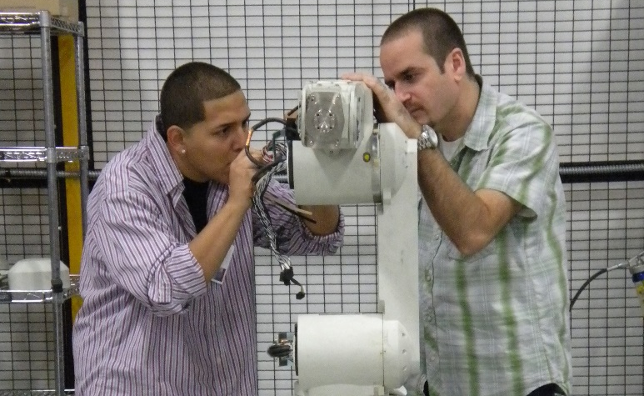
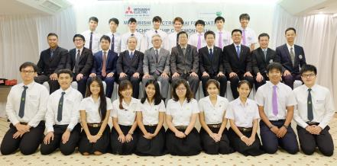
Philanthropic Foundations
Mitsubishi Electric America Foundation
Mitsubishi Electric Thai Foundation
Works to empower youth with disabilities
to lead productive lives by focusing on
Leadership Development, Employment Preparation, and Ability Awareness
Encourages today’s youth to be tomorrow’s leaders through a Scholarship Program, a Primary School Lunch Aid Program, and Volunteer activities with employees

Slide 19

Environmental Statement “Eco Changes”
Through a wide range of technologies and business segments for homes, offices, factories, infrastructure, and even outer space, we are helping contribute to the realization of a sustainable society. In line with our corporate statement, “Changes for the Better,” Eco Changes represents our efforts to join forces with our customers to change the global environment for the better.

Slide 20
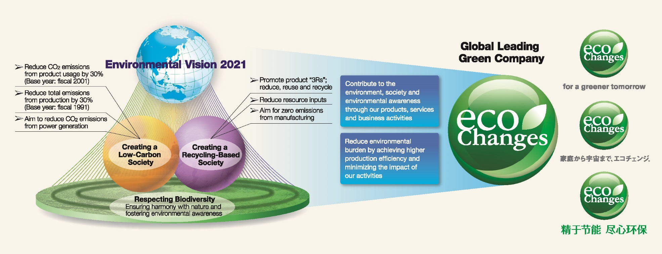
Environmental Activities
Carrying out our 8th Environmental Plan to help achieve Environmental Vision 2021
Environmental Vision 2021
Environmental Plan
Environmental Vision 2021 is Mitsubishi Electric's long-range vision for environmental management, which looks towards the year 2021
The 8th Environmental Plan, based on Environmental Vision 2021, went into effect in fiscal 2016 and will end in fiscal 2018

Slide 21
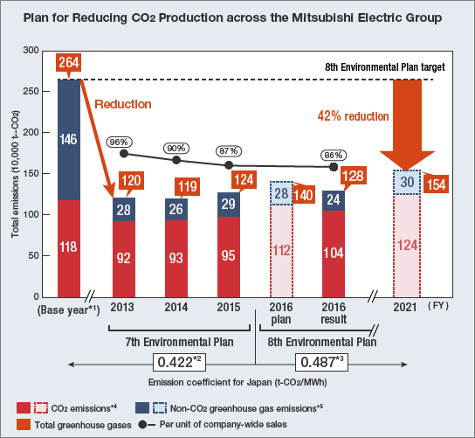
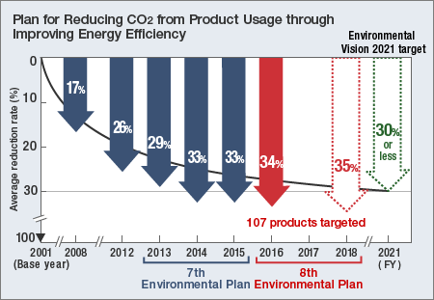
Environmental Activities
To help create a low-carbon society, we are working to reduce carbon
dioxide emissions from production and product usage
Reduction of CO2 from Production
Reduction of CO2 from Product Usage

Slide 22
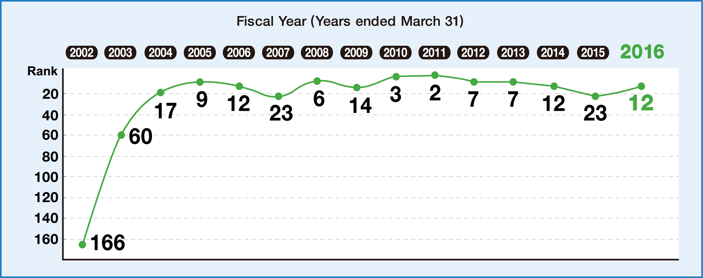
Environmental Activities
Ranked 12th among 413 manufacturers in Japan in the 19th
Nikkei Environmental Management Survey conducted by Nikkei Inc.
Nikkei Environmental Management Survey

Slide 23


Environmental Activities
Included on A list of CDP CLIMATE CHANGE 2016 and CDP WATER 2016 at first time.
A list logo of CDP climate change
A list logo of CDP WATER

Slide 24
Mitsubishi Electric Europe

Slide 25
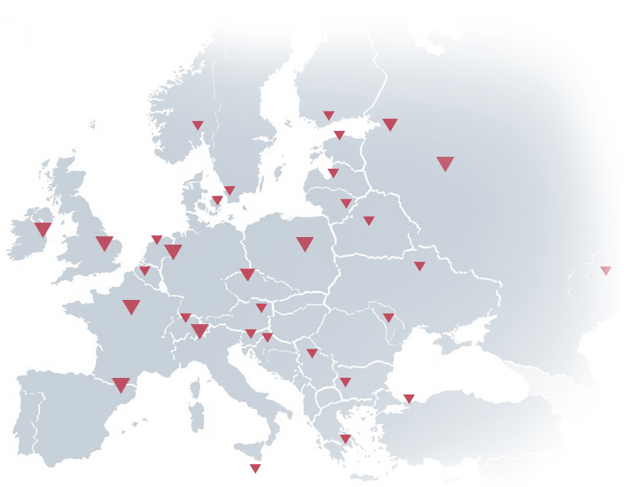
Mitsubishi Electric Europe
Over 30 succesful years in Europe
Sales companies in 13 countries
3 R&D Centres
4 factories
Many distributors

Slide 26
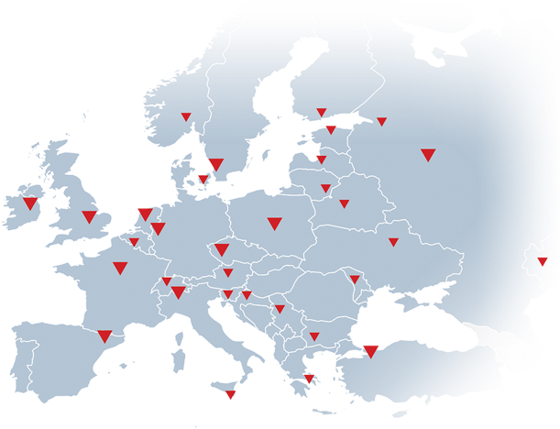
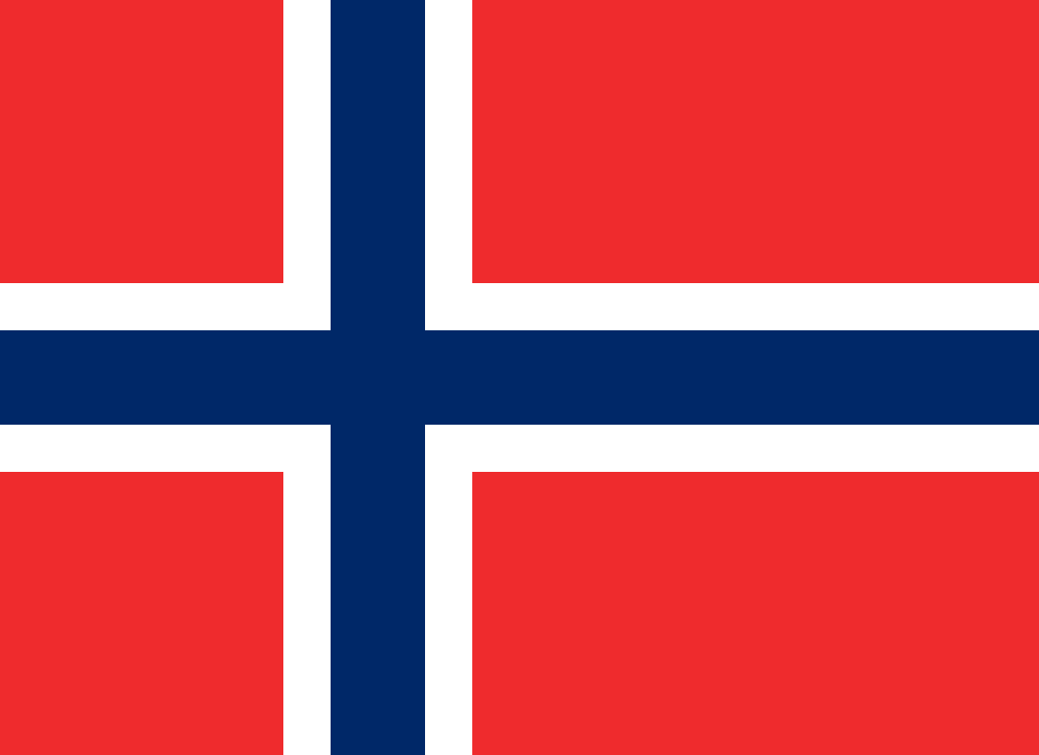
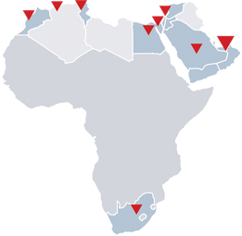
Factory Automation in EMEA
Support in local languages throughout EMEA
Network of over 50 Mitsubishi partners
More information at 25 local websites
Europe Eu
Belgium Fr
Belgium Nl
Bulgaria Bg
Czech Cz
France Fr
Germany De
Greece Gr
Hungary Hu
Ireland En
Italy It
Morocco Mo
Netherlands Nl
Norway No
Poland Pl
Romania Ro
Russia Ru
Slovakia Sk
Slovenia Sl
South Africa En
Spain Es
Sweden Se
Tunisia Tu
Turkey Tr
UK Gb

Slide 27
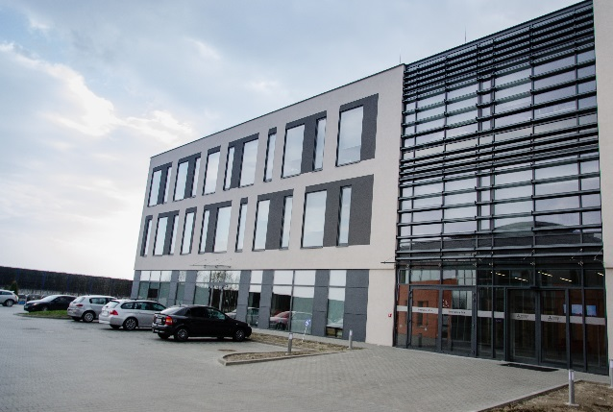
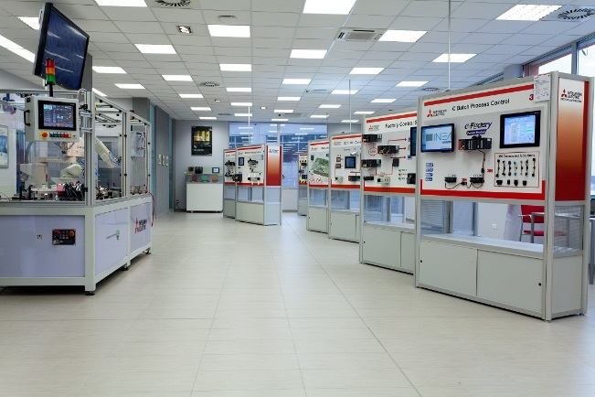
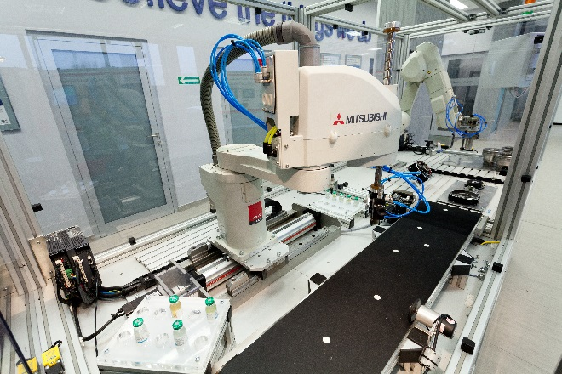
Mitsubishi Electric in Central Eastern Europe
Existing from 2009
Over 150 employees
Active in factory automation, CNC sells and service & Laser cutting machines, Airconditioning
Head-office for Central and Eastern Europe

Slide 28
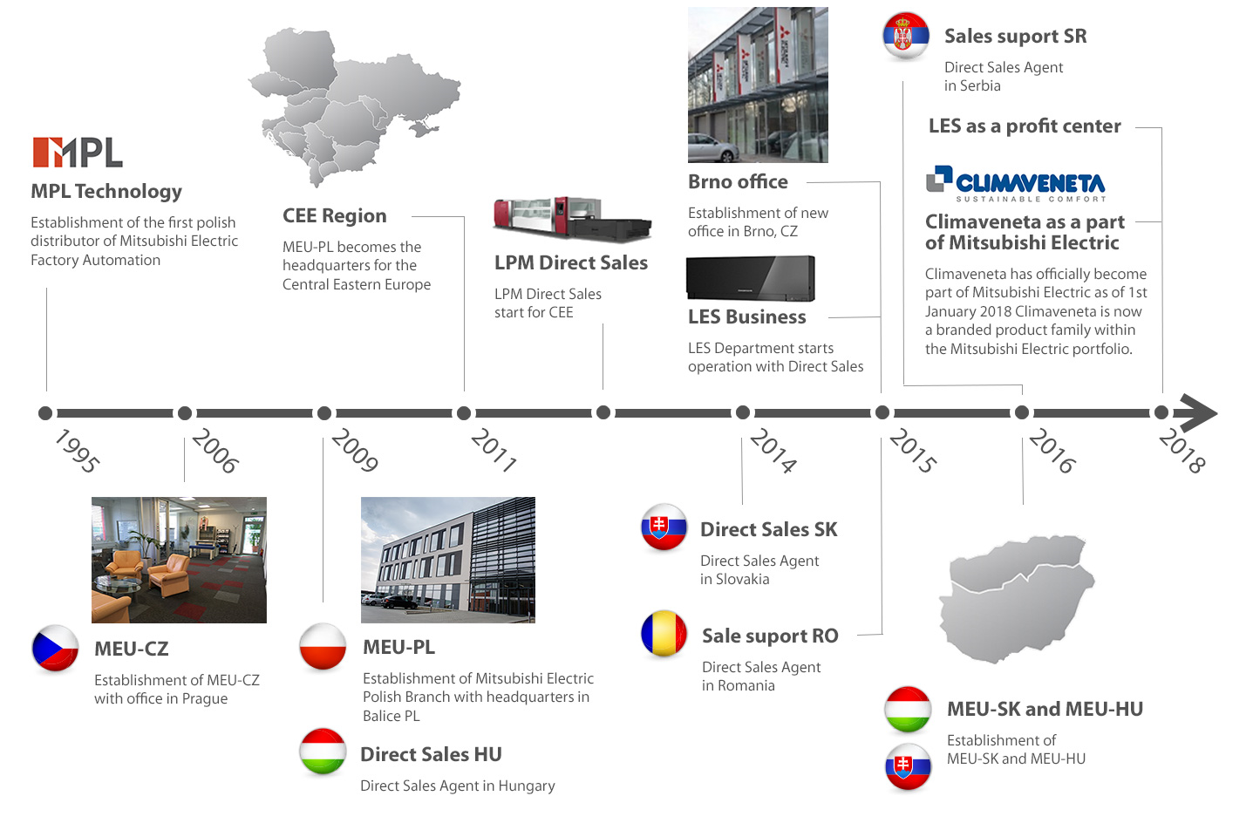
MEU-PL Milestones

Slide 29
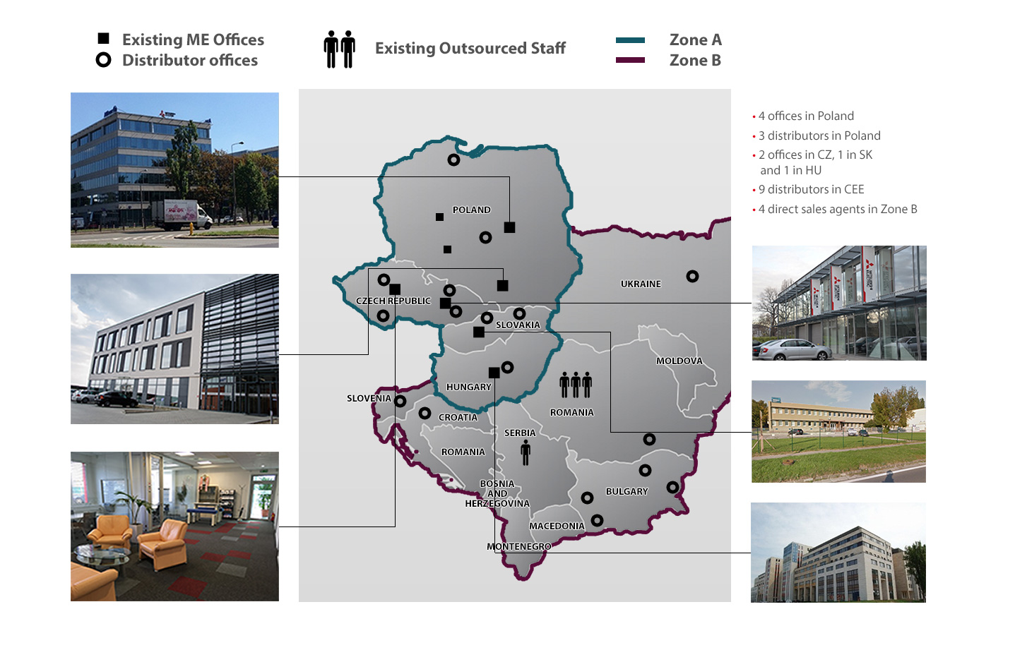
MEU-PL Milestones

Slide 30


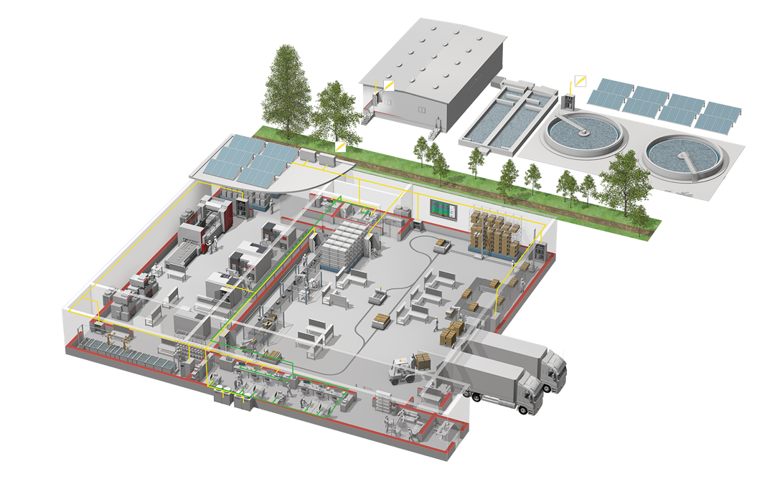
Factory Automation –
Product portfolio in EMEA
Software
HMI
PLCs
Inverter Drives
Motion Controllers
Servos
Motor Starters
Switchgear
Medium voltage solutions
Robots
CNC
EDM
Laser Processing

Slide 31
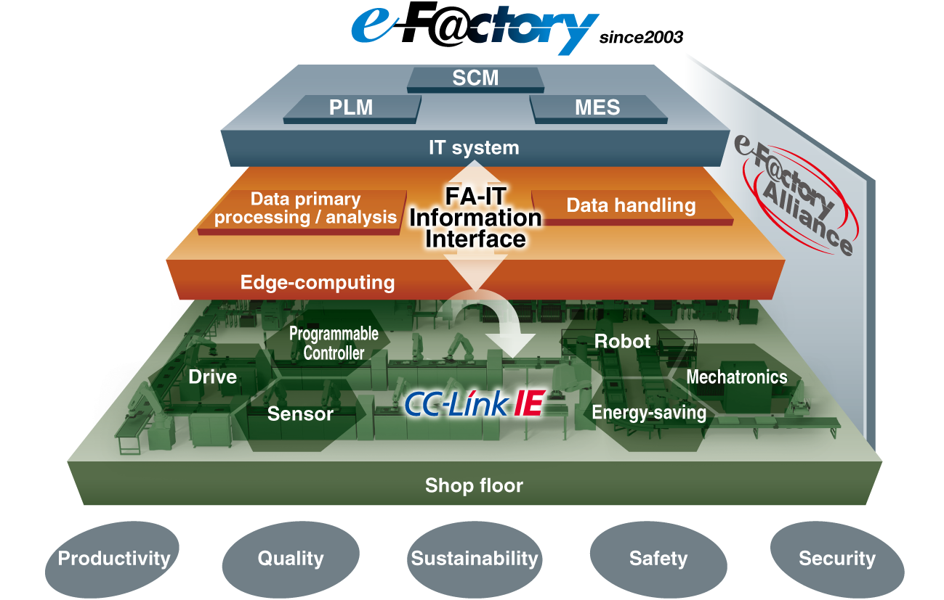
Factory Automation Systems
Providing quality automation equipment and systems
to major manufacturers for more than 90 years
Factory Network
e-F@ctory
Successful in increasing productivity and reducing production costs
Reduces data processing and response times
Optimizes production line scheduling
Allows more efficient management of site equipment
and resources
Enables remote diagnostics for faster maintenance
Efficiently integrates various equipment and
systems
Visualizes energy consumption on factory floors
with full coordination between energy measuring
equipment, PLC, and MES

Slide 32
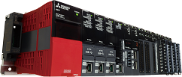
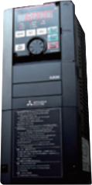
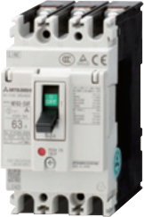
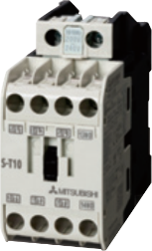
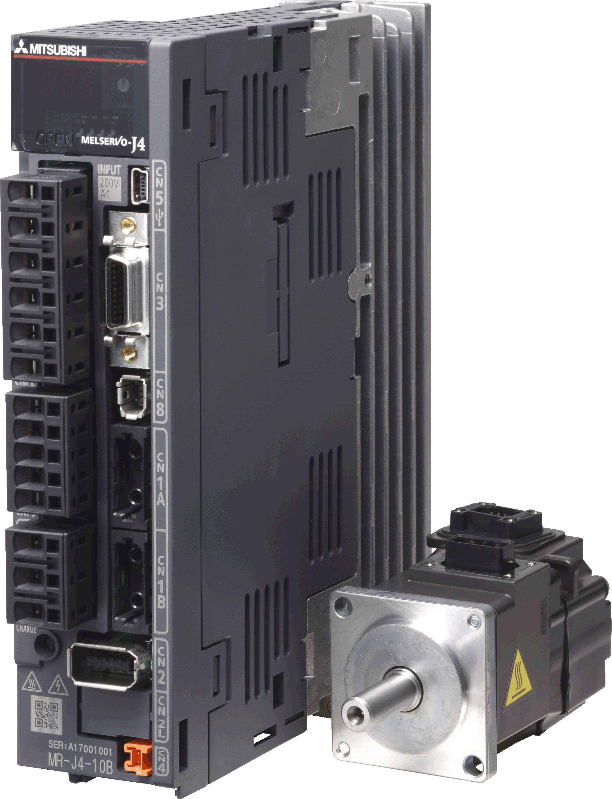

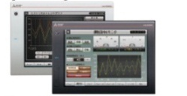

Factory Automation Systems
Helping companies make higher-quality products more efficiently,
while reducing costs
Automation Equipment
Power Distribution & Control Equipment
Ensuring high performance and high reliability
A comprehensive range of high-performance products offers the best solution in industrial automation
Low-voltage circuit breakers
Magnetic contactors
Programmable logic controllers (PLC)
Graphic operation terminals (GOT)
AC servo systems & motion controllers
Variable frequency drives (VFD)
Visualizing energy consumption
Energy measuring units

Slide 33









Factory Automation Systems
Meeting customer needs to ensure highly reliable production lines
Industrial Automation Machinery Products
Outstanding performance and technology in the industry
Electrical discharge machines (EDM)
Laser processing machines(LPM)
Computerized numerical controllers (CNC)
Industrial robots

Slide 34


A safe choice
Mitsubishi Electric can integrate the technologies of automation and safety into a single interactive system
This encompasses Control & Visualisation, Drives & Robotics and Devices & Components

Slide 35

A selection of our Food & Beverage customers
Fritsch
Allied Bakeries
British Bakeries
Banini A.D.
Krones
Virgin Cola
Braby
AB Technology
Milklink
Seydelmann
... and many more
All brand names and trademarks are the property of the respective companies

Slide 36

A selection of our water & waste
treatment customers
Hamburg Wasser - WWTP Köhlbrandhöft/Dradenau
WWTP Düsseldorf-Nord
ARA Sindlingen (Frankfurt/Main)
Zweckverband Bodensee-Wasserversorgung
Waterschap Rivierenland
Waterschap Vallei en Veluwe
Isle of Man Water & Sewage Auhority
Thessaloniki WWTP
Stockholm, Syvab’s Himmerfjärdsverket WWTP
Yorkshire Water
Welsh Water (DcWW)
South East Water Ltd
Wicklow County Council WWTP
Minsk Water Authority, Belarus
Tuzla-Istanbul WWTP
CHSPWIK Klimzowiec WWTP
JSC Moscow United Energy Company, Moscow, Russia
... and many more

Slide 37

A selection of our Automotive customers
FIAT
Honda/UK
Nissan/UK/SA/Russia
Toyota (7 Plants incl. Russia)
Volvo/Sweden
NED Car/Holland
Daewoo/Romania
Hyundai/Poland/Russia
MAN
KUKA
Mitsubishi Motors
Delphi
Chevrolet
Hella
Siemens VDO
Daimler
Bridgestone (8 plants)
Pirelli
Minsk Tractor Works
MAZ
Ford SA
Suzuki Hungary
All brand names and trademarks are the property of the respective companies

Slide 38

A selection of our Life Science
Ciba Vision
PAA Lab Automation
Intersurgical
Maquet (Getinge Group)
BASF
B.Braun Aesculap

Slide 39


Get the latest information on our websites
News
Product information
Catalogues, manuals and more
CAD drawings

Slide 40

A company you can rely on
Founded 1921
Turnover over 40 billion $US
Over 138,700 employees
30 factories in Japan

Slide 41

Thank you.
Danke.
Merci.
Grazie.
Gracias.
Teşekkürler.
شكرا
ありがとうございました。
謝謝。
спасибо

